Slide 1
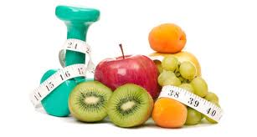
Nutrition and Weight Loss

Slide 2
Outline
Weight measures
Calories: men/women
Portion size
Fad diets
Adherence to diets
Conclusion

Slide 3
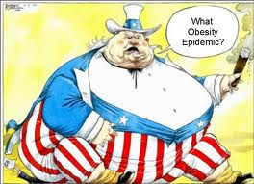
Weight of the World

Slide 4
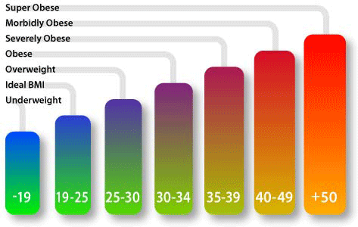
Body Mass Index (BMI)
BMI has been widely used as a measure of body fat and is cited by Keys et al (1972) as the best proxy for body fat percentage among ratios of weight and height
BMI was explicitly cited by Keys as being appropriate for population studies, and inappropriate for individual diagnosis. Nevertheless, due to its simplicity, it came to be widely used for individual diagnosis, despite its inappropriateness.

Slide 5
Calculating your BMI
BMI = mass (kg)
height(m)²

Slide 6
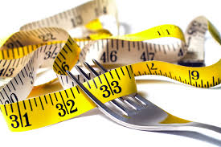
Calorie Allowances
Women: 1800-2000 calories per day
Men: 2000-2550 calories per day

Slide 7
Burning Calories
http://www.caloriecontrol.org/healthy-weight-tool-kit/lighten-up-and-get-moving

Slide 8
Cutting Calories to Lose Weight
3,500 calories in 1lb
Therefore to lose 1lb per week you need to cut
3500 = 500 calories per day from your diet
7
If calories are cut to 800-1000 per day, your metabolic rate adjusts to conserve the few calories you give your body- you won’t lose weight any faster if you allowed yourself 1,200 – 1,500 cals per day (20% Rule!)

Slide 9
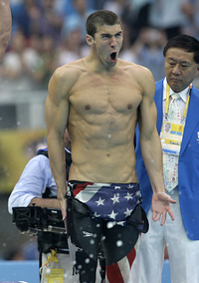
Athlete’s Calorie Intake
Laquale says cyclists in the Tour de France commonly consume a paltry 8,000 to 10,000 calories a day.
Michael Phelps’ well publicised calorie intake is at a staggering 12,000 per day

Slide 10
Michael Phelps’ Menu
Breakfast: Three fried-egg sandwiches loaded with cheese, lettuce, tomatoes, fried onions and mayonnaise. Two cups of coffee. One five-egg omelet. One bowl of grits. Three slices of French toast topped with powdered sugar. Three chocolate-chip pancakes.
Lunch: One pound of enriched pasta. Two large ham and cheese sandwiches with mayo on white bread. Energy drinks packing 1,000 calories.
Dinner: One pound of pasta. An entire pizza. More energy drinks.

Slide 11
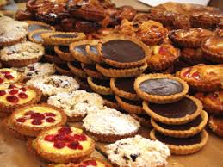
What Should We Eat
For an average 2000 calorie diet, the American Heart Association recommends:
Lean meat, skinless poultry and fish - no more than 6 oz. (cooked) per day; fatty fish eaten at least twice a week
Vegetables: 5 or more servings per day
Fruit: 3 servings per day
Fat-free milk and low-fat dairy products 2 – 3 servings per day
Breads, cereals, pasta and starchy vegetables 6 – 8 servings per day
Fats and oils 2 – 3 servings per day
Limit sweets and sugar intake

Slide 12
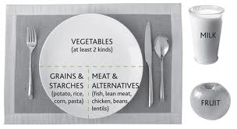
Portion Sizes
Eating large portion sizes is one of the biggest problems leading to weight gain.
The best way to look at your plate is to divide your plate into 4 parts.
When eating a pasta dish, a ¼ of the plate should be equal to your pasta portion. ¼ should equal your meat portion. And, the remaining ½ of your plate should be filled with watery, non-starchy vegetables.
This does not mean that you need to stick to one portion of pasta at a meal, but you should stick to the total recommended amounts in a day.

Slide 13
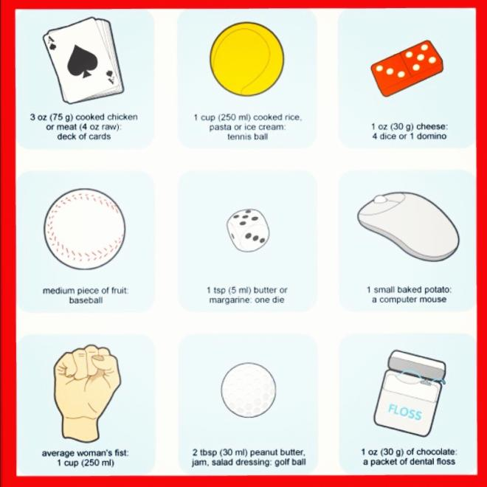
How Big is 1 portion?

Slide 14
Popular Diets
Dansinger et al (2005) compared the Atkins, Ornish, Weight Watchers, and Zone Diets for Weight Loss and Heart Disease Risk Reduction
All diets showed a modest weight decrease and a decrease in cardiac risk factors (only associated with weight loss)
However adherence rates were low

Slide 15
Adherence to Diets
Desroches et al (2013) examined the effects of interventions on diet adherence.
These included telephone follow up, video, contract, feedback, nutritional tools among many others.
The results were split with some studies supporting the use of interventions while others found no difference between the intervention group and the control group
Studies investigating interventions such as a group session, individual session, reminders, restriction and behaviour change techniques reported no diet adherence
The majority reported the adherence was short term only and did not show any effect in the long term

Slide 16
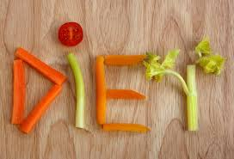
Adherence to Diets
Shaw et al (2009) examined psychological interventions for weight loss
Results: When behaviour therapy was combined with a diet & exercise approach and compared with diet & exercise alone, the combined intervention resulted in a greater weight reduction.

Slide 17
Conclusion
BMI is the universal calculation for body fat measurement
Cut calories in order to lose weight-but not drastically
Divide your plate into 4 quarters and remember your portion sizes!
Hire a hypnotherapist?

